Slide 1

THE AVENGERS Analytic Student Enrollment Data Analysis

Slide 2

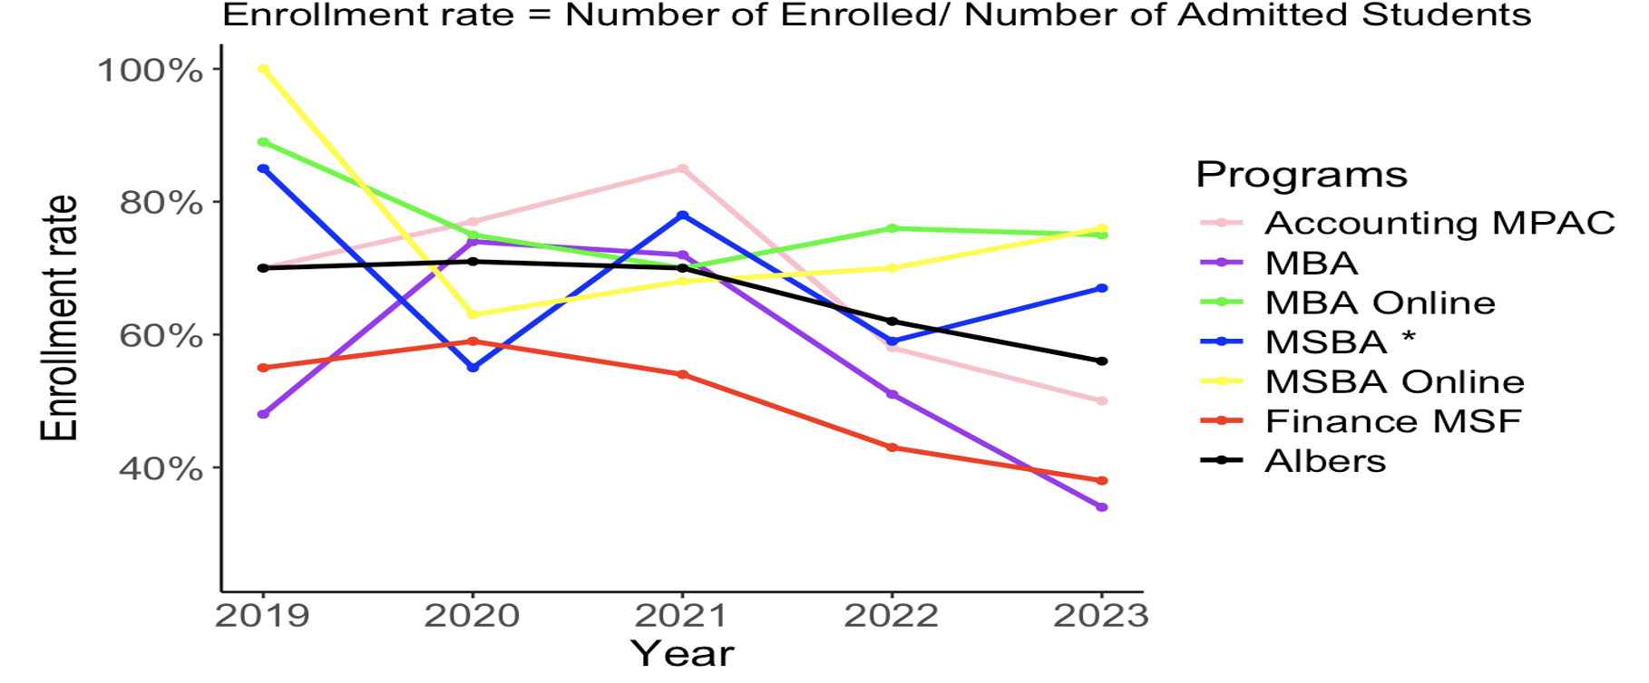
Key Data Insight From Analysis

Slide 3

Key Data Insight From Analysis

Slide 4
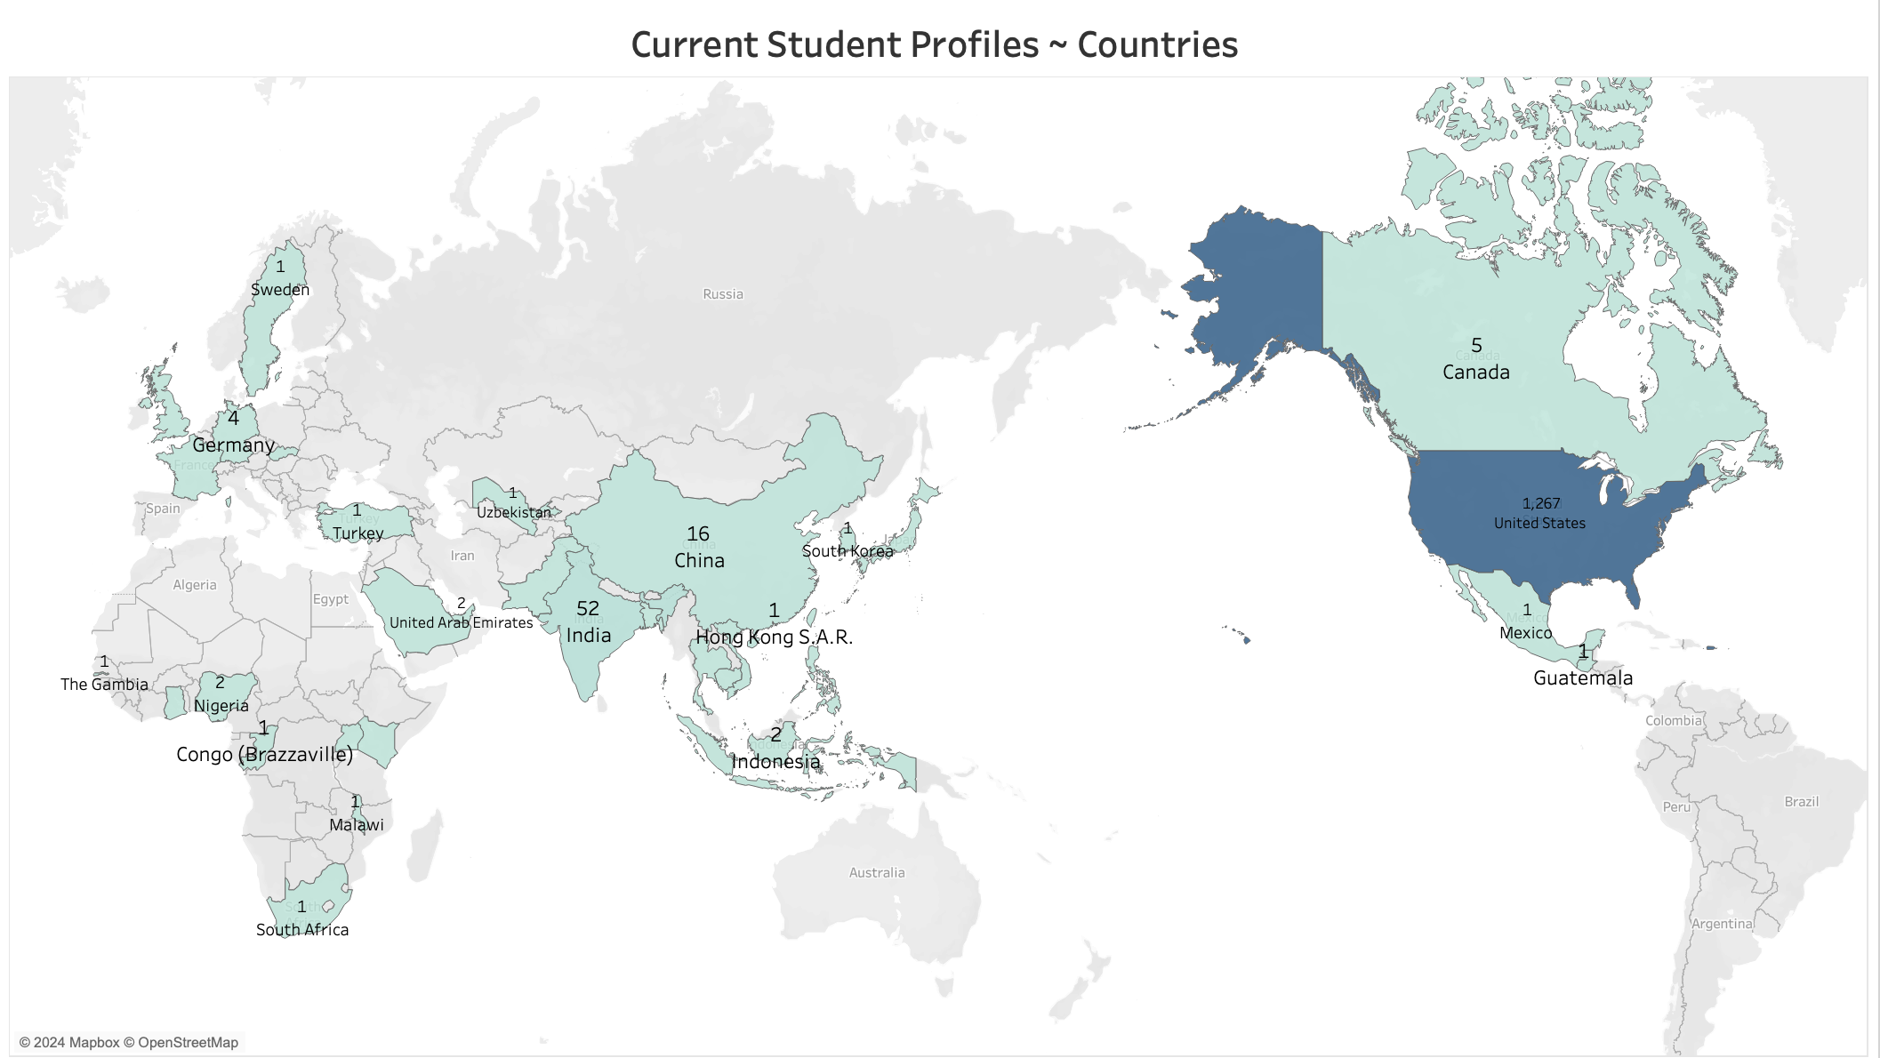
Current Student Profiles

Slide 5
Categorization of Variables
VARIABLE | SUB-CATEGORIES
Application Program | Finance, Accounting, JointDegrees/CertificateProgram, MBA, MBA/MSBAOnline, MBAOthers, MSBA
Application Start Term | 2017to2020, 2021, 2022, 2023, 2024to2025
Decision Reason | StudentAdmitted, Student_Not_Admitted
Gender | Male, Female
Predictor Variables:
Age | Decision Delay Days | Country (US) | Scholarship (Yes) | Sex (Male) | Student Admitted
Asian Indian | GPA Converted | Visa Required

Slide 6

Data Model and Metrics

Slide 7
Correlation Factors
Program Category | 1% level of significance | 5% level of significance | Not Significant | Key Insights
MSBA |  |  | Gender
MBA |  | Scholarship | Race | -Female more likely -Visa Required is highly significant
MBA Others |  | Age |  | Male more likely
Finance |  |  | Gender
Accounting |  |  | Race | Female more likely
JointDegrees/Certificate Programs | Scholarship | OtherRaces | Country | Female more likely
MBA/MSBA Online | Scholarship | StudentAdmitted | Country | Female more likely
 | Gender
Country (US)
Decision Delay in Days (-ve)
Scholarship (Yes)
Student Admitted
Race
Sex (Male)

Slide 8
Model Evaluation Metrics
Metrics:
Pseudo- R-squared: The model explains approximately 56.98% of the variance in the dependent variable
Coefficients: The coefficients for the predictor variables indicate the direction and strength of their relationship with the log odds of the outcome variable being 1.
Test Accuracy: 0.9116
Test Precision: 0.7367
Test Recall (Sensitivity): 0.8095
Model Recommendation:
We noticed comparable results between Logistic regression and Decision Tree model.
We would recommend Logistic model because:
Suitability for Binary Outcomes (Applications registered in college)
Easy interpretability of results (correlation factors and their significance)
Easy to understand the likelihood of matriculation as it predicts probabilities
It can capture nonlinear relationships between the independent variables

Slide 9
Key Findings and Insights
Insights from the Data:
Scholarships --> Qualified students get offers from higher ranking schools --> more likely to drop if College does not offer more
Majority Applicants are from North America --> Possibly drop due to pandemic recovering, savings, mortgage, fear of future income
Increase in International Students/Employees --> higher visa decline rate by immigration
Politics --> Students who graduated pre-covid (2020) might want to continue the visa through a higher degree from undergraduate; 2023-24 were no longer the case
Other External Factors:
Cost of Living Disparity
Erosion of Community Trust --> Internal Cares
Prestige Decline --> Words of Mouth

Slide 10
Appendix
Concepts and Tools Used:
- Python, R, Tableau, Data Preparation, Analysis, Interpretation, Visualization, Machine Learning.
- Logistic Regression - Machine Learning Model (Modelled Program wise)
- Linear Regression using polynomial features of training data– For predicting number of students matriculating in 2024 and 2025
References:
- Scikit-learndevelopers.sklearn.preprocessing.PolynomialFeatures. Scikit-learn, from https://scikit-learn.org/stable/modules/generated/sklearn.preprocessing.PolynomialFeatures.html
Categorization of Decision Reason:
- Student_Admitted: Admit Regular, Admit Conditional, Admit Probation, Admit Conditional & Probationary, Admit Conditional & Bridge, Deposit Paid, Deposit Waived/Not Required, Deposit - Not Required, Update Major - Post Decision, Update Term - Post Decision, Update Term & Major - Post Decision, Update Term - Post Enroll(CF), Update Major - Post Enroll(CF), Update Term & Major - Post Enroll(CF), No Show - Post Enroll(CF), Scholarship Adjustment, Update Term - Pre Decision, Update Term & Major - Pre Decision, Update Major - Pre Decision
- Student_Not_Admitted: Admit Declined, Admit Declined - Post Enroll(CF), Rejected - Soft Deny, Rejected - No Alternatives, Rejected - Waitlist Den, Waitlist Invite, Waitlist Accepted, Waitist Declined, Waitlist Closed, Other Reason, Decision Delayed, Application Closed, Application Closed - Wrong Program/Duplicate Application, Application Closed – Miscellaneous, Application Closed – Fraud, Application Closed - Unrecognized/Unaccredited Inst or Prog, Application Complete – Closed, Application Incomplete – Closed, Request to Close
Notes:
MBA, MSF have courses in Summer! May be we should have other courses also in the Summer to increase the matriculation rate

Slide 11

Thank You! Q/A?

